Slide 1
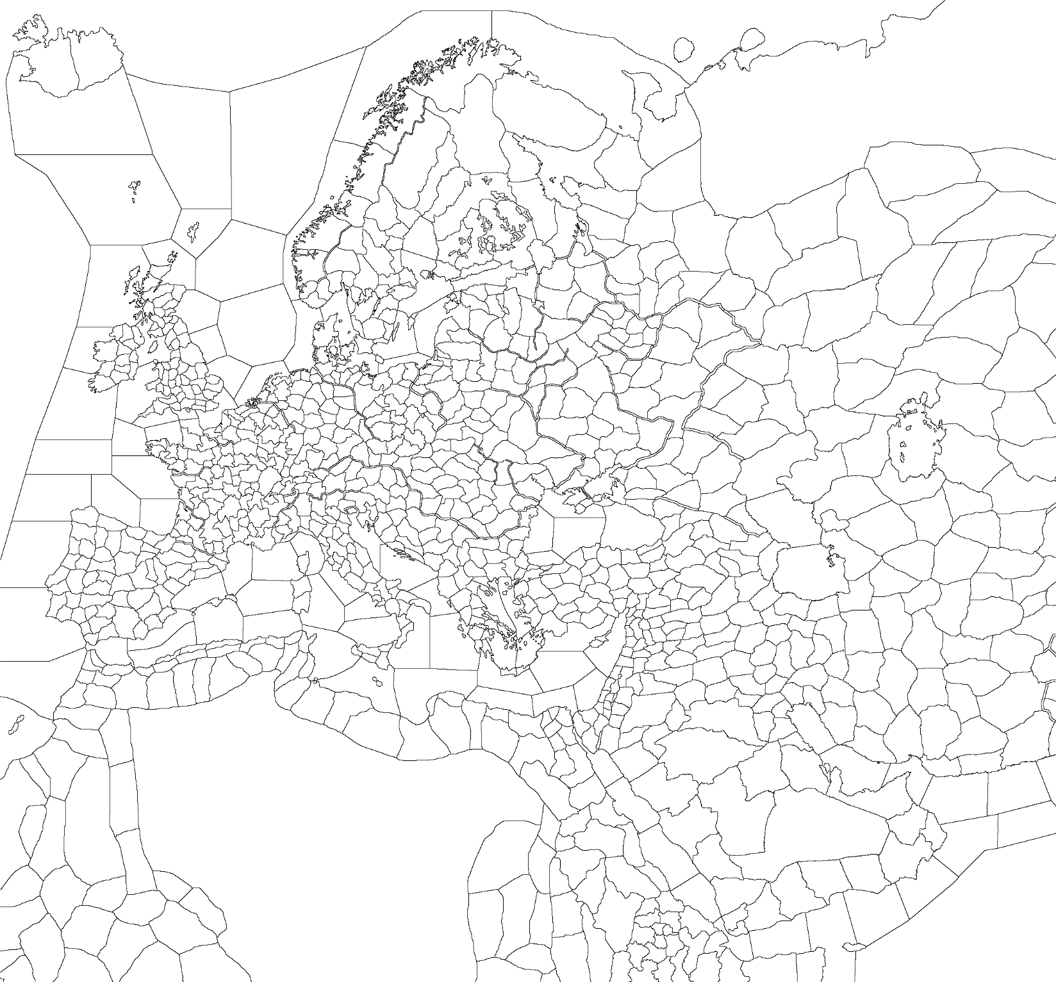
Template (Western)
Religious Structure and Holy Sites
Shared Holy Sites
Mainstream Religion and its Heresies:
1
Catholic
Heresies: Text, Text, Text
Autonomous Religions:
2
Text
3
Text
4
Text
5
Text
6
Text
7
Text
8
Text
9
Text
10
Text
11
Text
Religion: unreformed religion
Religion: reformed religion

Slide 2

Template (Eastern)
Religious Structure and Holy Sites
Shared Holy Sites
Mainstream Religion and its Heresies:
1
Catholic
Heresies: Text, Text, Text
Autonomous Religions:
2
Text
3
Text
4
Text
5
Text
6
Text
7
Text
8
Text
9
Text
10
Text
11
Text
Religion: unreformed religion
Religion: reformed religion
Text
Text
Text
Text

Slide 3
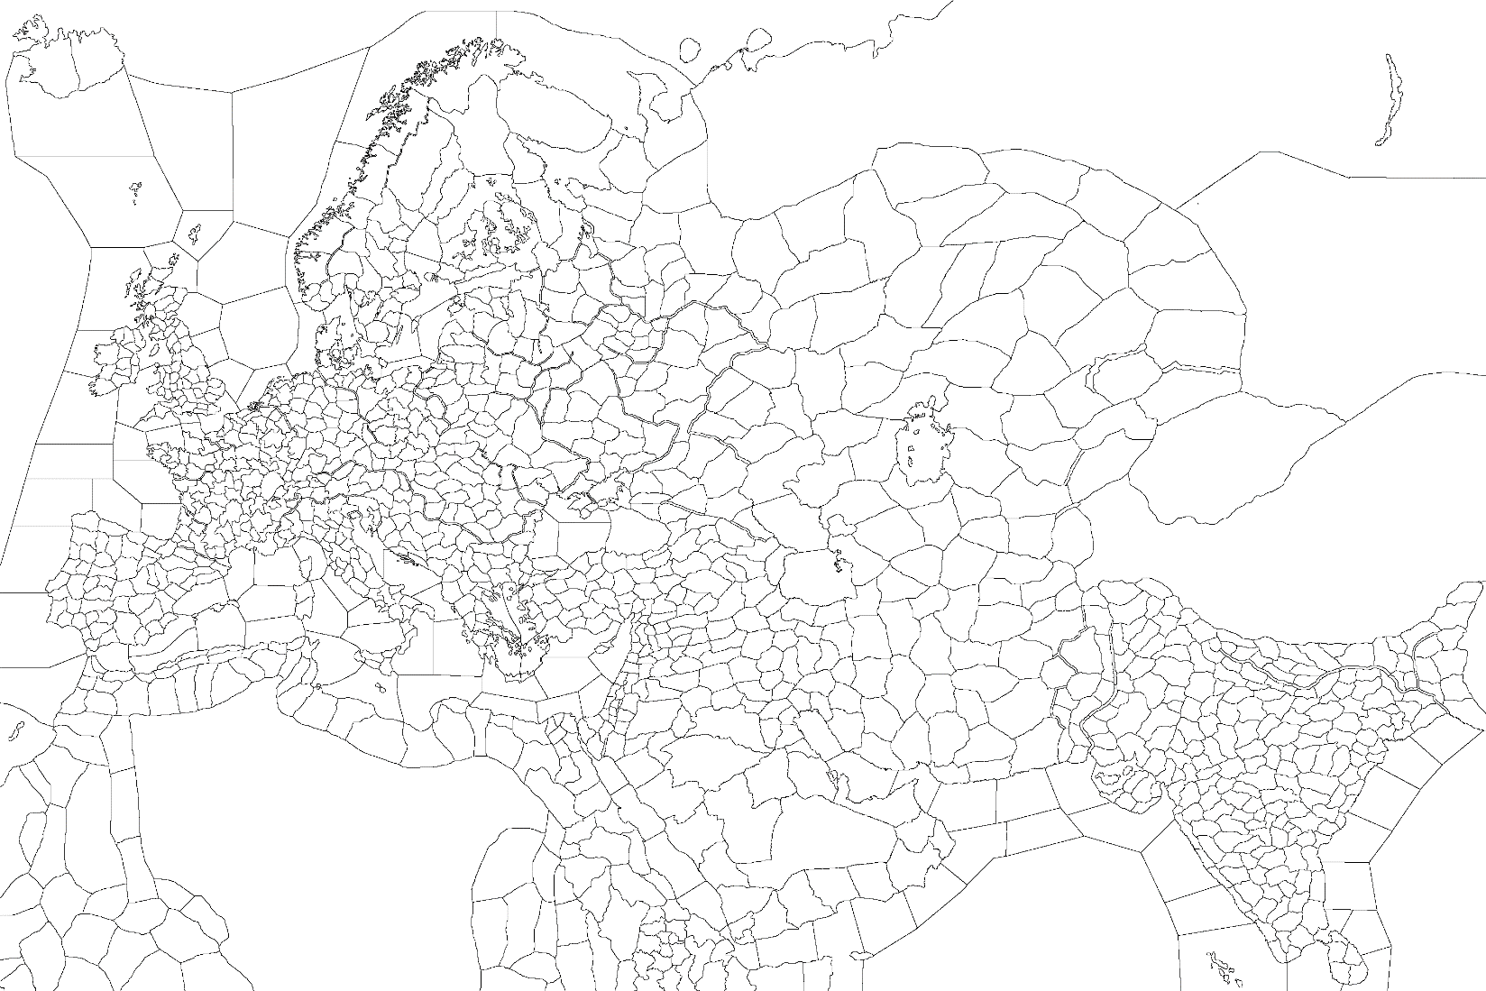
Template (Whole Map)
Religious Structure and Holy Sites
Shared Holy Sites
Mainstream Religion and its Heresies:
1
Catholic
Heresies: Text, Text, Text
Autonomous Religions:
2
Text
3
Text
4
Text
5
Text
6
Text
7
Text
8
Text
9
Text
10
Text
11
Text
Religion: unreformed religion
Religion: reformed religion
Text
Text
Text
Text

